Slide 1
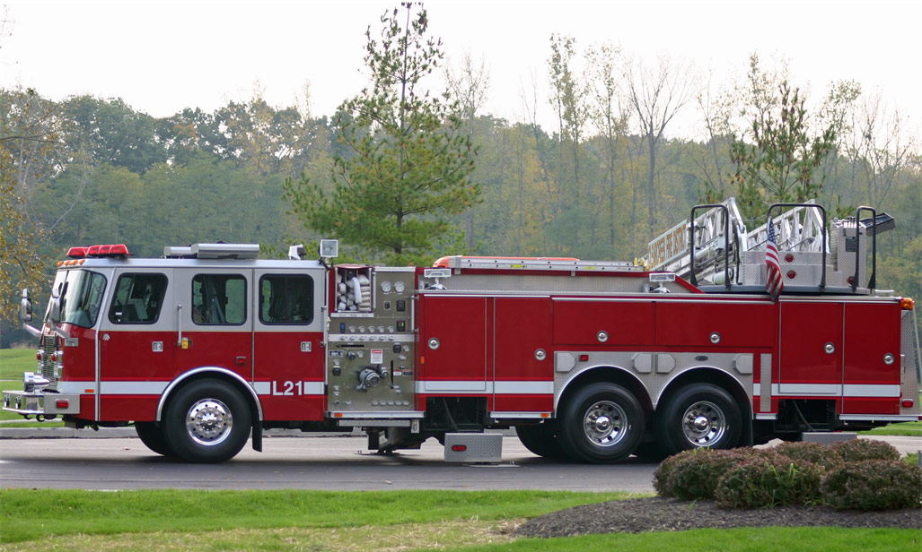
Emergency Action Plan

Slide 2
Introduction
How to Use this Presentation
DISCLAIMER
This training material presents very important, pertinent information. It should not be assumed, however, that this program satisfies every legal requirement of every state. Some states require the training be developed and delivered by an individual with specific training and experience.
This training is AWARENESS LEVEL and does not authorize any person to perform work or validate their level of competency; it must be supplemented with operation and process-specific assessments and training, as well as management oversight, to assure that all training is understood and followed.
Your organization must do an evaluation of all exposures and applicable codes and regulations. In addition, establish proper controls, training, and protective measures to effectively control exposures and assure compliance.
This program is neither a determination that the conditions and practices of your organization are safe, nor a warranty that reliance upon this program will prevent accidents and losses or satisfy local, state, or federal regulations.
This presentation contains base material for use in an instructor-led training setting. You may modify this presentation to satisfy the specific training needs of your organization.
On some slides, the display text is supplemented with additional material in the slide notes.
This content is licensed for modification and use in a classroom setting. You may not redistribute this material in any form.

Slide 3
Learning Objectives
Introduction
Develop an emergency action plan
Assign responsibilities
Understand the process
Learn steps in handling emergencies
Address natural disasters that may affect the workplace
Notes:
In this training course, you will learn how to:
Develop an emergency action plan based on hazards and other potential emergencies
Assign responsibilities to employees
Understand the process of deploying an emergency action plan
Learn the initial steps in handling medical, fire, and other emergencies
Address natural disasters that may affect the workplace.

Slide 4
Course Overview
Introduction
Developing a Plan
Fire and Medical Emergencies
Extended Power Loss
Chemical Spills
Telephone Bomb Threats
Severe Weather and Natural Disasters
Notes:
The course will discuss:
developing an emergency action plan
medical emergencies
fire emergencies
extended power loss
chemical spills
telephone bomb threats
severe weather and natural disasters

Slide 5
Developing a Plan
1
What you need to know:
The definition of an Emergency Action Plan (EAP)
The EAP’s components
Requirements for evacuation maps
Training requirements

Slide 6
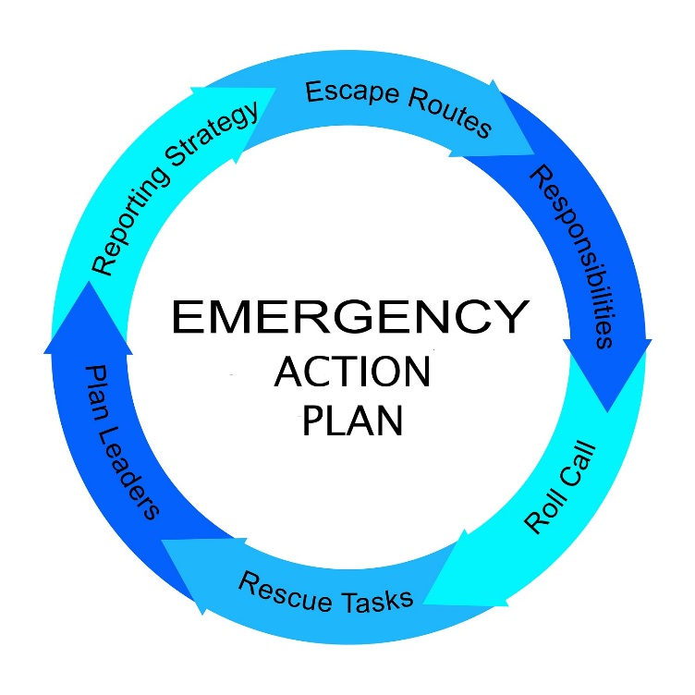
Definition
1 Developing a Plan
Provides step-by-step procedures
Addresses natural disasters
Includes who to notify and who has been assigned tasks
Must be in writing, kept in the workplace, and available for review
Notes:
When emergency response procedures are known, practiced, and followed in emergency situations, the emergencies will result in fewer injuries and damage to a facility.
Emergency action plans, or E-A-P’s, provide step-by-step procedures for employees to follow in case of an emergency, such as a fire, chemical spill, or major accident. EAPs also address natural disasters that can affect a workplace, such as floods, hurricanes, or tornadoes.
The emergency action plan includes information, such as:
who to notify in case of an emergency
who has been assigned evacuation
rescue, medical, or critical plant operation tasks.
The EAP must also include the name and job title of every employee who may be contacted for more information about the plan or for an explanation of duties.
EAPs must be in writing, kept in the workplace, and available for review. However, if an employer has ten or fewer employees, the plan may be communicated orally.

Slide 7

Defining the Scope
1 Developing a Plan
Who will develop, implement, and maintain the plan
All facilities that could be impacted
Separate plans for each facility
Off-site work
Notes:
The first step in developing an emergency action plan is deciding who will develop, implement, and maintain the plan. Recruiting employees to participate with management in the development of the plan will increase employee commitment and support.
The emergency plan needs to include all facilities that could be impacted in the event of an emergency.
Some organizations may have separate plans for each facility, depending on activities performed at each site, such as the handling of hazardous materials. Others may include off-site work in their EAPs.

Slide 8

Assessing Hazards and Risks
1 Developing a Plan
Hazards
Types of emergencies
All components of business
How each emergency would affect each component
Offices, manufacturing facilities, and remote locations
Response for all potential emergencies
*
Some emergencies, such as chemical spills, may have regulatory reporting requirements: determine and include these in the EAP.
Notes:
Start by determining the hazards present in the workplace that can cause an emergency.
Also list other types of emergencies that could impact your facility, such as power failures or weather emergencies. This will vary based on geographic location, type of business, and size of the business.
Next, consider all components of the business and how each potential emergency would affect each component. Include the possibility of a long term business shutdown. Consider any offices, manufacturing facilities, and remote locations that would impact organizational operations.
Develop a response for all potential emergencies identified. Once the scope of the necessary preparation is defined, a plan needs to be developed and implemented to cover each of these areas.

Slide 9
Assigning Responsibility
1 Developing a Plan
Designate specific individuals responsible for various tasks:
  Reporting the emergency
  Monitoring the evacuation
Performing rescue, medical, or critical plant operation duties
Determining closure periods
Contacting utilities
Addressing chemical spill clean-up
Address expectations of each employee.
*
Document training and additional responsibilities.
Notes:
Once the scope of the plan and hazards are defined, the plan needs to designate specific individuals as responsible for various tasks.
These tasks may include the following:
reporting the emergency, both internally to other employees and externally, such as when summoning outside assistance
monitoring the evacuation of the facility
performing rescue, medical, or critical plant operation duties before evacuating
determining closure periods.
If there are any utilities in danger of being affected by the emergency, the corresponding utility company needs to be contacted by an assigned individual. If chemical spills are a possibility, an individual needs to be assigned to address clean-ups and report the spill.
The expectations of each of these responsible employees needs to be addressed in detail. This may include additional training on assigned tasks.

Slide 10

Outlining Procedures
1 Developing a Plan
What to do in the event of a fire or other emergency
How to report emergencies and alert employees
How to account for all employees after an evacuation
What to do in the event of a business closure
How to respond to natural disasters
How employees will be trained
Notes:
Once the potential emergencies are determined and the employee responsibilities are assigned, outline the procedures that the organization will go through during an emergency in detail.
These procedures will be specific to the hazard response and the affected employees.
Procedures will include the following:
what do to in the event of a fire or other emergency, including evacuation procedures and exit routes
how to report emergencies and alert employees
how to account for all employees after an evacuation
what to do in the event of a business closure
how to respond to natural disasters, such as where to assemble if the workplace is threatened by a tornado
how employees will be trained and how often.

Slide 11
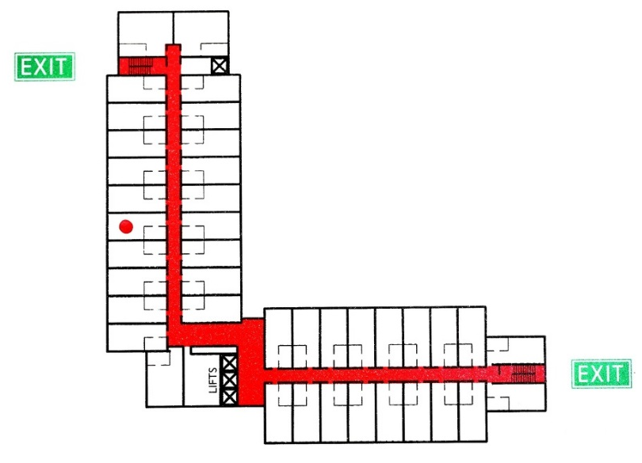
Evacuation Maps
1 Developing a Plan
Emergency exits
Primary and secondary evacuation routes
Locations of fire extinguishers
Fire alarm pull station locations
Assembly areas
Assembly
area
*
Site personnel should know at least two evacuation routes from their primary work area.
Notes:
EAPs include evacuation maps. The following information, at a minimum, is noted on these maps:
emergency exits
primary and secondary evacuation routes
locations of fire extinguishers
fire alarm pull station locations
assembly areas, where a head count will be conducted.
The EAP must specify how often evacuation drills are conducted. Usually this is done annually and additionally if there are any changes to the workplace or procedures.

Slide 12

Training
1 Developing a Plan
Expectations and responsibilities
Threats and hazards
Emergency response procedures
Notification, warning, and communication
Locations
Practice drills
Duties
Hazards unique to the jobsite
Notes:
Once a detailed plan has been developed that outlines the requirements in the event of an emergency, the resulting policy is distributed to employees.
Employees must be trained on the plan so that they understand expectations and responsibilities.
The training will include the following:
threats and hazards at the workplace
the appropriate emergency response procedures
procedures for notification, warning, and communication
location of evacuation routes and on-site shelters
the location of fire extinguishers, alarms, and other emergency equipment
practice drills
duties specific to individuals assigned to various roles, such as medical, rescue, or shutdown responsibilities
and other hazards unique to the jobsite that affect employees.
Emergency action plans need to be reviewed and updated annually. All changes need to be communicated to employees.

Slide 13
Fire and Medical Emergencies
2
What you need to know:
Fire alarm procedures
First steps after being notified of a fire
Important roles
Criteria for extinguishing a fire
Response requirements for medical emergencies

Slide 14
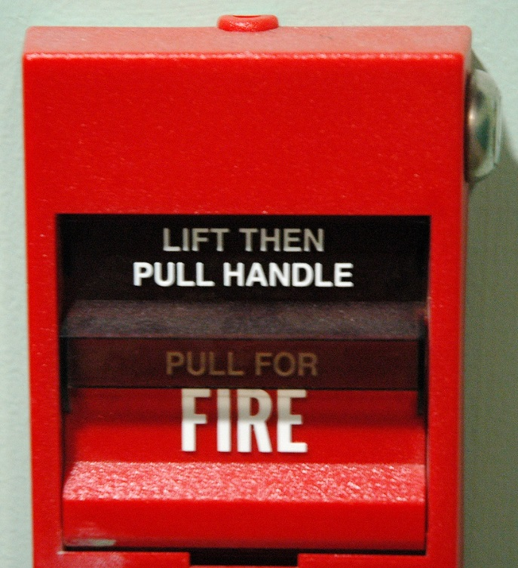
Fire Emergencies
2 Fire and Medical Emergencies
When a fire is discovered:
Activate the nearest fire alarm.
If no alarm is available, notify the fire department.
Notify site personnel:
Voice communication
Radio
Phone
Other method
*
Many buildings are equipped with smoke alarms and sprinklers that will automatically activate if there is smoke or sufficient heat.
Notes:
When a fire is discovered, EAPs typically direct employees to activate the nearest fire alarm.
Fire alarm pull stations, such as the one pictured, alert the local fire department as well as sounding an alarm. If no manual or automatic alarm is available, immediately notify the local fire department by calling 911.
Notify the site personnel designated in the EAP about the fire emergency by the specified method, which may be voice communication, radio, phone, or some other method.

Slide 15
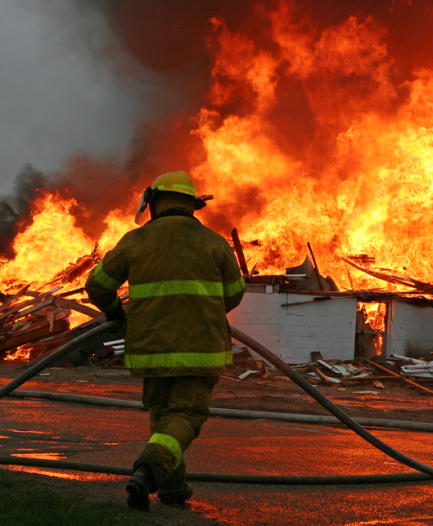
After Being Notified
2 Fire and Medical Emergencies
Leave the building using evacuation routes.
Assemble in the designated area.
Remain outside until it is safe to re-enter.
Report problems to the emergency coordinator.
Notes:
Immediately after being notified of a fire emergency, all occupants in the facility, including visitors, must:
Leave the building using designated evacuation routes.
Assemble in the designated area as detailed in the emergency action plan.
Remain outside until the assigned competent authority announces that it is safe to re-enter.
Report any problems to the emergency coordinator at the assembly area.

Slide 16

Work Area Monitors
2 Fire and Medical Emergencies
Assure that all physically-challenged employees are assisted in evacuation.
Confirm that all employees and visitors have evacuated.
Perform an accurate head count.
Report missing personnel.
Notes:
Work area monitors identified in the emergency action plan must assure that all physically challenged employees are assisted in an emergency evacuation.
In addition, they must sweep their assigned areas to confirm that all employees and visitors have evacuated the area.
Once they reached the designated assembly area, they must perform an accurate head count and report any missing personnel to the responsible individual.

Slide 17
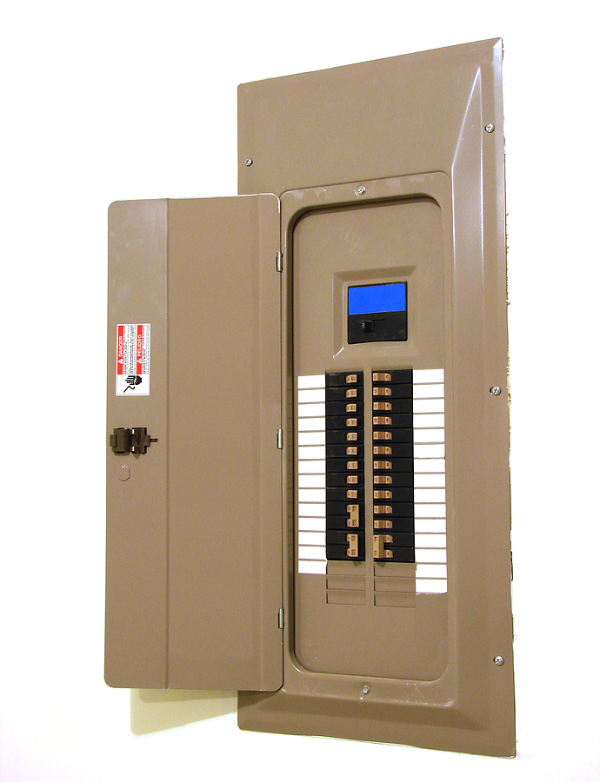
Other Designated Personnel
2 Fire and Medical Emergencies
Operate fire extinguishers.
Disconnect utilities and equipment.
Shut windows and doors.
Provide the fire personnel with necessary information.
Perform an assessment and coordinate emergency closing procedures.
Notes:
Other designated personnel in the EAP may be required to do the following tasks:
operate fire extinguishers
disconnect utilities or equipment that could be damaged if it is left operating or that could create additional hazards to emergency responders, unless doing so jeopardizes their safety
shut windows and doors before evacuating if it’s safe to do so
provide the fire personnel with necessary information about the facility and headcount
If it’s not possible to return to the area after the emergency, perform an assessment and coordinate emergency closing procedures.

Slide 18
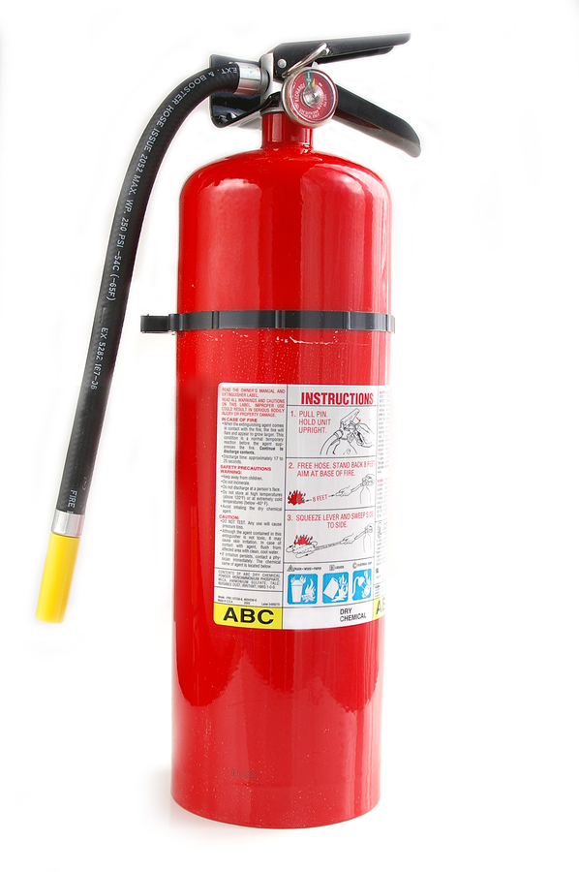
Extinguishing Fires
2 Fire and Medical Emergencies
Criteria for extinguishing fires:
The fire department has been notified.
The fire is small and is not spreading.
Escaping the area is possible.
The fire extinguisher is working.
You are trained.
You are assigned.
Notes:
Extinguish the fire only if all of the following criteria are met:
the fire department has been notified
the fire is small and is not spreading to other areas
escaping the area is possible by backing up to the nearest exit
the fire extinguisher is in working condition
you are trained to use the extinguisher and you are assigned to do so in the EAP.

Slide 19

Medical Emergencies
2 Fire and Medical Emergencies
Call for help.
Provide information:
  Nature of emergency
  Location
  Your name
  Phone number
Do not move a victim unless necessary.
Seek first aid assistance.
Notes:
Emergency action plans address how medical assistance is provided.
Typically, in the event of a medical emergency, the EAP directs employees to do the following:
First, call for help by shouting to nearby employees
Then call the appropriate emergency phone numbers as soon as possible. Who to call is noted in the EAP, and will depend on whether a facility has a formal internal medical program or relies on local emergency services.
If unsure whether the situation is an emergency, call the emergency number and explain the situation. The dispatcher will ask questions and assist in providing appropriate care.
Provide the following information to the dispatcher:
the nature of the medical emergency
the location of the emergency, including the address, and the building or room number, if applicable, your name and the phone number you are calling from.
Do not move a victim unless it is absolutely necessary, such as when there is imminent danger from fire, explosion, or electrocution.
Workplaces without formal internal medical programs usually have employees trained in first aid, including CPR and AED use. Seek their assistance in all medical emergencies.

Slide 20
Extended Power Loss
3
What you need to know:
Steps to take after power loss
Steps to take upon the restoration of power

Slide 21

Precautionary Measures
3 Extended Power Loss
Turn off unnecessary electrical equipment and appliances.
Turn off and drain the following:
  The fire sprinkler system
  Standpipes
  Potable water lines
  Toilets
Add non-toxic antifreeze to drains.
Move equipment containing fluids that may freeze.
Notes:
In the event of an extended power loss to a facility, certain precautionary measures must be taken by authorized personnel, depending on the location and environment of the facility. Determine which measures apply to your facility and include them in the emergency action plan.
Turn off unnecessary electrical equipment and appliances, because power restoration could cause a surge that damages electronics and other sensitive equipment.
If the facility is likely to experience freezing temperatures during a long-term power loss, turn off and drain the following:
The fire sprinkler system
Standpipes
Potable water lines
Toilets
Add non-toxic antifreeze to drains to prevent drain traps from freezing.
Move equipment containing fluids that may freeze due to long-term exposure to freezing temperatures to heated areas, and either drain the liquid or provide the equipment with an auxiliary heat source.

Slide 22
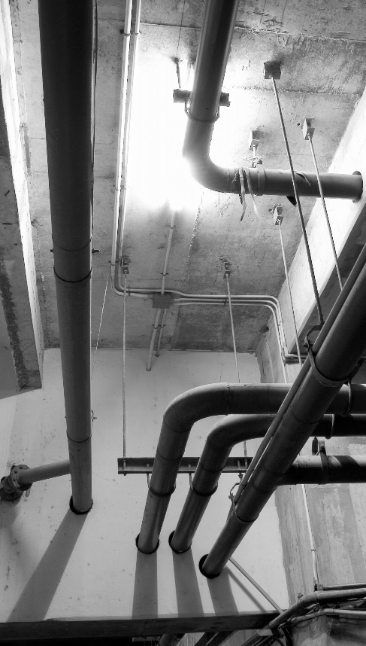
When Power Returns
3 Extended Power Loss
Electronic equipment should be brought up to ambient temperatures before energizing.
Check fire and water piping for leaks.
Notes:
Upon the restoration of heat and power:
Electronic equipment should be brought up to ambient temperatures before energizing to prevent condensation from forming on circuitry.
After the heat has been restored to the facility and water has been turned back on, authorized personnel will check fire and water piping for leaks from freeze damage.

Slide 23
Chemical Spills
4
What you need to know:
Procedures for large chemical spills
Procedures for small chemical spills

Slide 24
Procedures for a Large Chemical Spill
4 Chemical Spills
Immediately notify the designated official or emergency coordinator.
Evacuate the building as necessary.
Secure the area.
Attend to injured personnel.
Call the medical emergency number if required.
Begin containing the spill only if trained and authorized.
Activate the spill cleanup procedures.
Notes:
If your facility handles large amounts chemicals or other hazardous substances, include procedures for handling spills in your EAP, such as the following:
immediately notify the designated official or emergency coordinator about the spill, including the name of the material, its physical properties and hazards, the amount spilled, the exact location of the spill, and whether there are any injuries
evacuate the building as necessary
secure the area
attend to injured personnel, and call the medical emergency number if required
begin containing the spill only if you are trained and authorized to do so, using appropriate equipment, such as pads, booms, or absorbent powder
activate the spill cleanup procedures by contacting the designated personnel.

Slide 25
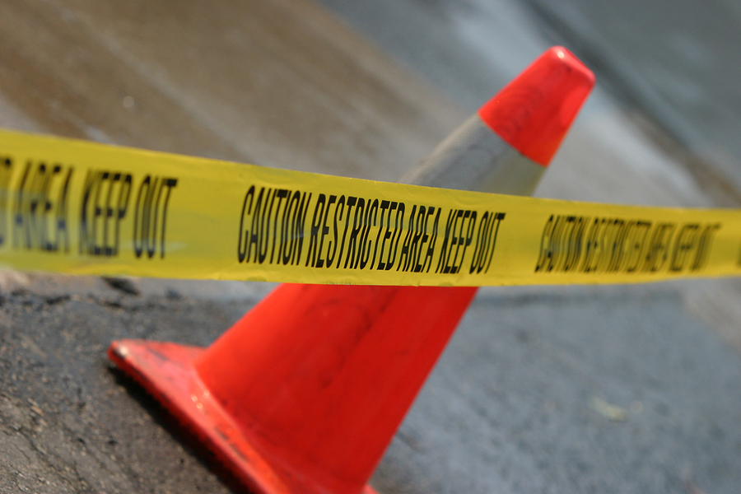
Procedures for a Small Chemical Spill
4 Chemical Spills
Immediately notify the designated official or emergency coordinator.
Secure the area with caution tape or cones.
Review the spill cleanup procedures.
Deal with the spill according to the SDS.
*
Even small spills must be handled in a safe manner.
Notes:
The following are procedures for a small chemical spill:
immediately notify the designated official or emergency coordinator
secure the area with caution tapes or cones to prevent other personnel from entering, especially if the material is toxic, corrosive, or flammable
review the general spill cleanup procedures
deal with the spill in accordance with the instructions described in the safety data sheet, or SDS.

Slide 26
Telephone Bomb Threats
5
What you need to know:
How to handle a threatening call
Steps to take after the call

Slide 27

Handling a Telephone Bomb Threat
5 Telephone Bomb Threats
Treat all threats seriously.
Stay calm and be courteous.
Listen, and do not interrupt.
Keep the caller talking.
Fill out a checklist with observations.
Write a note to a colleague.
Notes:
The number of bomb threats has been increasing, and responses to bomb threats are included in many organization’s emergency action plans.
Treat all bomb threats seriously.
In the event of a telephone bomb threat:
stay calm and be courteous. Listen, and do not interrupt the caller.
Keep the caller talking as long as possible.
As you listen, fill out a checklist, which is available from the Federal Emergency Management Agency’s website, as fully as possible with observations about the caller.
If it’s possible to do so, write a note to a colleague to call authorities while you are still on the phone.

Slide 28

At the End of the Call
5 Telephone Bomb Threats
Activate a malicious call trace.
Hang up the phone and do not answer it.
Call personnel and provide information.
If a description of the bomb location was given:
Communicate this information.
Determine whether the caller appeared familiar with the facility.
Write out the message.
Notify your supervisor.
Notes:
At the end of the call, do the following:
activate a malicious call trace
hang up the phone and do not answer it if it rings again
call personnel responsible for corporate security functions and provide information about the call
if a description of the bomb location was given, communicate this information and determine whether the caller appeared familiar with the facility by their description of the bomb location
write out the caller’s message in its entirety and any other comments on a separate sheet of paper and attach to the checklist
notify your supervisor immediately.

Slide 29
Severe Weather and Natural Disasters
6
What you need to know:
General procedures for:
  Tornadoes
  Earthquakes
  Flood or tsunamis
  Hurricanes
  Blizzards
How to stay safe while stranded in a vehicle

Slide 30
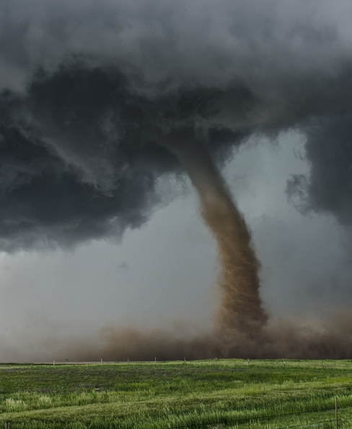
Tornadoes
6 Severe Weather and Natural Disasters
Immediately go to your designated on-site shelter.
If there is no on-site shelter, go to a windowless, interior room or hallway on the lowest floor.
Stay away from outside walls and windows.
Use your arms to protect your head and neck.
Remain sheltered.
Notes:
Emergency action plans typically include procedures to follow if natural disasters common to the area threaten a workplace.
Tornadoes can occur almost anywhere, but are more common and severe in some areas.
When a tornado warning is issued by sirens or other means, immediately go to your designated on-site shelter.
If there is no on-site shelter, go to a windowless interior room or hallway on the lowest floor of the building.
Stay away from outside walls and windows.
Use your arms to protect your head and neck.
Remain sheltered until the designated individual announces that the tornado threat is over. This is described as “sheltering-in-place.”

Slide 31
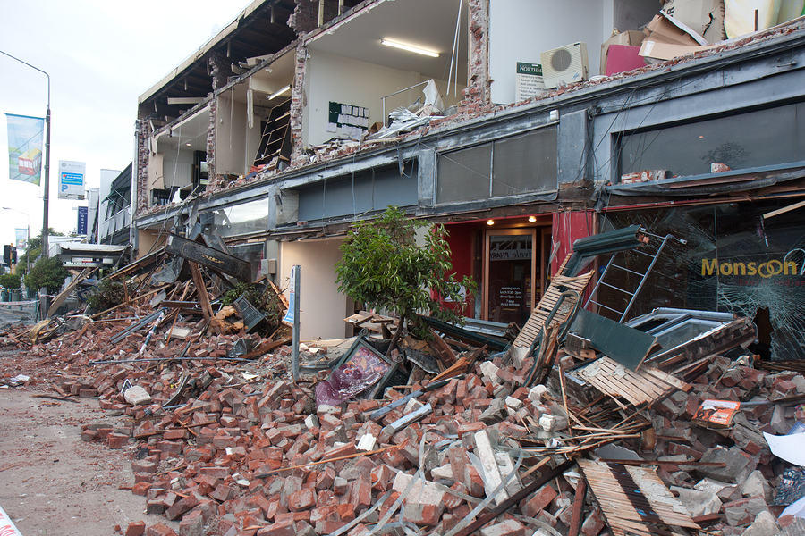
Earthquakes
6 Severe Weather and Natural Disasters
Get under a protective structure and hold on.
Keep your head down.
Keep away from overhead fixtures, windows, filing cabinets, and electrical power sources.
Stay in your safe place and remain calm.
Evacuate only if instructed.
If outside, stay outside, and move away from buildings, trees, and power lines.
Be on the lookout for fires.
Be ready for aftershocks.
Notes:
Earthquakes can occur almost anywhere, at any time of year, and are impossible to predict.
Most earthquake-related injuries result from collapsing walls, flying glass, and falling objects as a result of the ground shaking, or people trying to move more than a few feet during the shaking.
If an earthquake starts:
Immediately get under a close-by sturdy desk, table, or other protective structure, and hold onto it.
Protect your eyes by keeping your head down.
Keep away from overhead fixtures, windows, filing cabinets, and electrical power sources.
Stay in your safe place and remain calm until your designated emergency coordinator gives an all-clear signal or issues further directions, or until the shaking stops.
Evacuate only if instructed by your emergency coordinator.
If you are outside when an earthquake starts, stay outside and move away from buildings, trees, and power lines.
Be on the lookout for fires. Fire is the most common earthquake-related hazard, due to broken gas lines, damaged electrical lines or appliances, and previously contained fires or sparks being released.
Be ready for aftershocks.

Slide 32
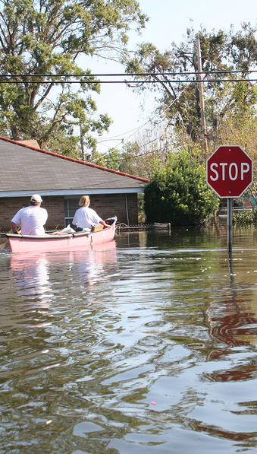
Flood or Tsunami
6 Severe Weather and Natural Disasters
If indoors:
Be ready to evacuate.
Follow the recommended routes.
If outdoors:
Follow evacuation routes or climb to high ground and stay there.
Avoid walking or driving through water.
If your vehicle stalls, abandon it.
Notes:
If a flood or tsunami alert is issued and you are indoors, be ready to evacuate, as directed by your emergency coordinator or other designated official, and follow the recommended primary or secondary evacuation routes.
If the alert is issued and you are working outdoors, for example at a remote jobsite, follow evacuation routes or climb to high ground and stay there.
Avoid walking or driving through flood water.
If your vehicle stalls, abandon it immediately, and climb to a higher ground.

Slide 33
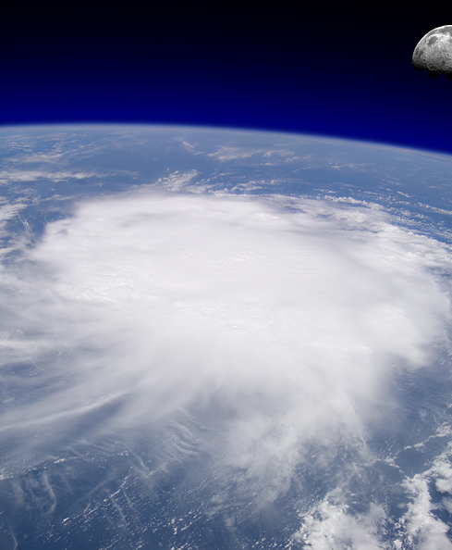
Hurricanes
6 Severe Weather and Natural Disasters
A watch is issued when a hurricane becomes a threat.
A warning is issued when winds of 74 mph or dangerously high water is expected within 24 hours.
Once a hurricane watch has been issued:
Stay calm.
Await instructions.
Monitor local TV and radio stations.
Secure the building.
Prepare machinery and equipment.
Notes:
The nature of a hurricane provides for more warning than other natural and weather disasters. A hurricane watch is issued when a hurricane becomes a threat to a coastal area.
A hurricane warning is issued when hurricane winds of 74 mph or higher or a combination of dangerously high water and rough seas is expected in the area within 24 hours.
Once a hurricane watch has been issued:
Stay calm and await instructions from your emergency coordinator or other designated official.
Monitor local TV and radio stations for updates.
Employees designated in the EAP may be asked to secure the building against winds and possible flooding, and to prepare machinery and equipment for a power loss.

Slide 34
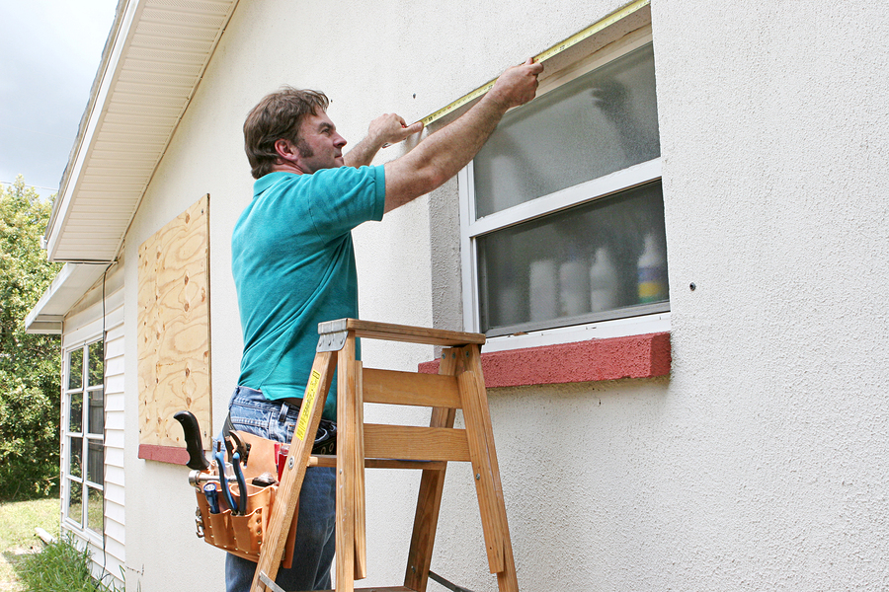
Hurricanes
6 Severe Weather and Natural Disasters
When a hurricane hits:
Remain indoors.
Choose a shelter:
A small, interior room without windows on the lowest floor
Hallway away from doors and windows on the lowest floor
A room with no windows constructed with reinforced concrete, brick, or block
If flooding is expected, avoid the lowest floor.
Notes:
If you are at your workplace when a hurricane hits, and it’s no longer safe to evacuate, remain indoors.
Choose a shelter with the following options:
a small interior room without windows on the lowest floor
a hallway away from doors and windows on the lowest floor
or a room with no windows constructed with reinforced concrete, brick, or block.
Please note that if flooding is expected, you may need to avoid the lowest floor.

Slide 35

Blizzards
6 Severe Weather and Natural Disasters
Stay calm.
Await instructions.
Stay indoors.
If there is no heat:
Close off unneeded rooms or areas.
Stuff towels or rags in cracks under doors.
Cover the windows at night.
Eat and drink.
Wear layers.
Notes:
Blizzards are another weather emergency usually predicted in advance. If a blizzard occurs and you don’t have time to evacuate your workplace, stay calm, await instructions from emergency coordinator or other designated official, and stay indoors.
If there is no heat:
Close off unneeded rooms or areas.
Stuff towels or rags in the cracks under doors.
Cover the windows at night.
Eat and drink. Food provides the body with energy and heat. Fluids prevent dehydration.
Wear layers of loose-fitting, light-weight, warm clothing, if available.

Slide 36

Stranded in a Vehicle
6 Severe Weather and Natural Disasters
Stay in the vehicle.
Run the motor about 10 minutes/hour.
Open the windows a little.
Make sure the exhaust pipe is not blocked.
Make yourself visible to rescuers.
Turn on the dome light at night.
Tie a colored cloth to your antenna or door.
Raise the hood after snow stops falling.
Exercise.
Notes:
If your business is in an area prone to blizzards, and employees work at remote jobsites or are frequently on the road, include in your EAP procedures for them to follow if they become stranded in a vehicle during a blizzard.
Stay in the vehicle.
Run the motor about ten minutes each hour. Open the windows a little for fresh air to avoid carbon monoxide poisoning. Make sure the exhaust pipe is not blocked.
Make yourself visible to rescuers.
Turn on the dome light at night when running the engine.
Tie a colored cloth to your antenna or door.
Raise the hood after the snow stops falling.
Exercise to keep blood circulating and to keep warm.

Slide 37
Summary
Finish
  Outlines steps to follow in event of emergency
  Includes procedures for reporting, evacuating, accounting, and responding
  Designates employees responsible
  Assures that employers and employees know procedures and roles
Includes:
  Medical
  Fire
  Power
  Chemical
  Bomb threats
  Severe weather and natural disasters
Notes:
An emergency action plan is a written or oral plan outlining steps a workplace will follow in the event of an emergency.
It includes procedures for:
reporting emergencies
evacuating a facility or sheltering-in-place as appropriate
accounting for all employees
responding to emergency situations.
EAPs also designate employees responsible for rescue, medical, and critical plant operations. Employee training will assure that employers and employees know the procedures and their roles when emergencies strike.
Possible emergency situations include medical, fire, power, chemical, and bomb threats.
Severe weather and natural disasters such as tornadoes, hurricanes, earthquakes, floods, and blizzards, depending on a facility’s geographic location, also need to be addressed.

